Slide 1
PMO Purpose
The purpose of a Portfolio Management Office (PMO) is to provide project management best practices and services to ensure consistent utilization of standards and processes.
A major intermediate PMO goal is to realize results by successfully implementing projects within the triple constraint--on time, within budget, and according to specifications.
The ultimate PMO goal is to have satisfied customers!
Dr. Richard Scudder Copyright 2018
1
Notes:
1

Slide 2
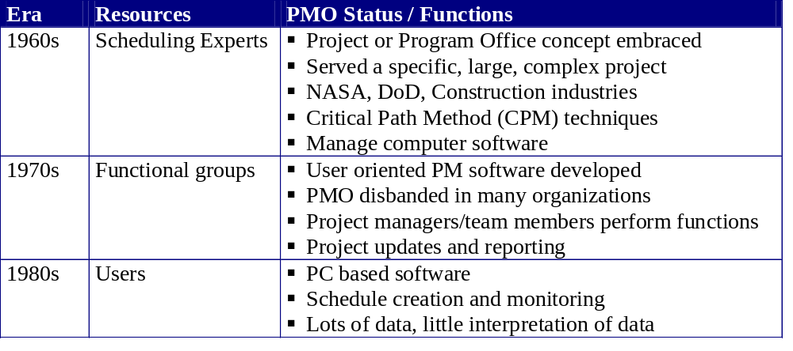
History of the PMO
*Sources: PM Network, May 1997, Richard Murray, The Role of the Project Support Office.
Thomas R. Block & J. Davidson Frame, The Project Office 1998 Crisp Publications.
Dr. Richard Scudder Copyright 2018
2
Notes:
2

Slide 3
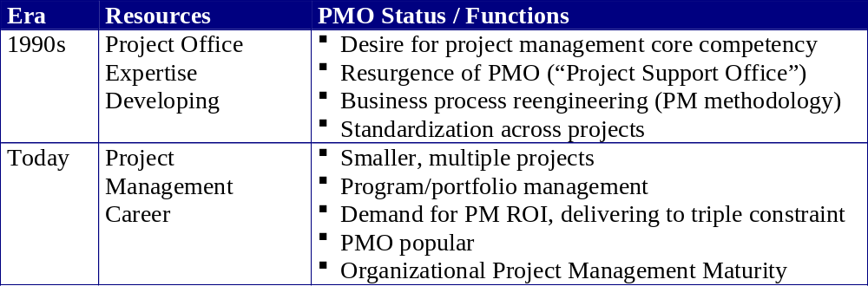
History of the PMO
*Sources: PM Network, May 1997, Richard Murray, The Role of the Project Support Office.
Thomas R. Block & J. Davidson Frame, The Project Office 1998 Crisp Publications.
Dr. Richard Scudder Copyright 2018
3
Notes:
3

Slide 4

Current Trends
Program/portfolio management
Organizational Project Management Maturity Models
Project management as a career
  PMI: PMO CAQ™
      (Certificate of Added Qualification)
PMBOK alignment to win business
Dr. Richard Scudder Copyright 2018
4
Notes:
4
The Project Management Office Certification of Added Qualification (for PMPs) is designed to expand the project management profession within the Project Management Office industry and provide credentials that individuals and organizations can rely on. It is also intended to support the attainment of practitioner's development and career goals by having a positive impact on their professional knowledge, performance, and project-related opportunities.
http://www.pmi.org/prod/groups/public/documents/info/pdc_pmocaqhandbook.pdf

Slide 5

PMO Benefits
Consistent ways of managing projects
Shorter project ramp-up time
Reduced learning curves for project teams and clients
Consistent methods of measuring and
tracking progress
Management of
issues & risks
Higher quality
products and services.
Faster delivery to market
Cost savings/increased return on investment
Increased efficiency
Success in meeting
business objectives
Increased customer satisfaction
Dr. Richard Scudder Copyright 2018
5
Notes:
5

Slide 6

Steps to Establish a PMO
Review organization strategic goals, mission statement, business plan, business objectives, current initiatives
Ask and investigate:
Where is the organizational “pain”--where is the organization falling short in achieving its strategy and objectives?
What are the organization’s strengths and challenges?
What is the organization’s receptivity to change?
Is there a need for formalized project management?
Dr. Richard Scudder Copyright 2018
6
Notes:
6

Slide 7
Selling PM to Executives
“Savvy systems-thinking project managers position themselves as interpreters of strategy. If they’re doing the job well at the project level, they’re making the connection to how the project supports the strategic needs of the organization. They’re able to give it meaning and context.”
- Paul Shalty, PMP, Catalyst Management Consulting LLC
“Bridging the Gap Supporting Organizational Project Management” PM Network November 2001.
Dr. Richard Scudder Copyright 2018
7
Notes:
7

Slide 8
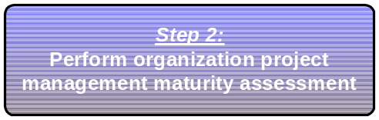
Steps to Establish a PMO
Select an organization project management maturity (OPMM) model, e.g., Kerzner, PMI, or developed in-house
Assess:
Project management methodology and tools against PMBOK
Organization project management best practices
Project management culture
How many projects does the organization concurrently manage, frequency, complexity, type and size?
Project metrics and trends
Dr. Richard Scudder Copyright 2018
8
Notes:
8

Slide 9

Steps to Establish a PMO
Organization-wide PMO
  Frame/Block
  The Project Office
  “Full Service Provider”
  Owns project management
Functions:
Methods, standards, tools (comprehensive)
Training, consulting and mentoring (project start-ups, runaways)
Project management staff (project managers, project analysts)
Project management competencies and career path
Management of projects from initiation through closure
Measurement across projects (trends/improvement opportunities)
Dr. Richard Scudder Copyright 2018
9
Notes:
9

Slide 10
Steps to Establish a PMO
Project Focused PMO
  Managing on a
  project-by-project basis
  Owns projects
Functions:
Project management framework (some tools, processes, procedures)
Project management staff (project managers, project analysts)
Dr. Richard Scudder Copyright 2018
10
Notes:
10

Slide 11
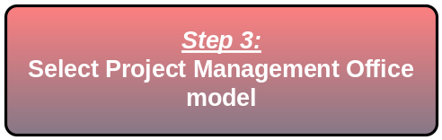
Steps to Establish a PMO
Project Support PMO
  Majority of project management staff resides
  in functional areas
  Supports projects
Functions:
Project management standards and reporting
Project support staff (project analysts)
Dr. Richard Scudder Copyright 2018
11
Notes:
11

Slide 12
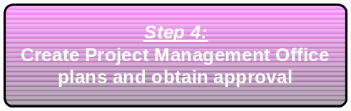
Steps to Establish a PMO
Build a foundation using project management industry standards and solid requirements
Establish:
Project management charter
Project office advisory council
Standard processes and procedures for
execution across all projects
An implementation approach
Dr. Richard Scudder Copyright 2018
12
Notes:
12

Slide 13
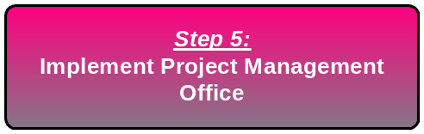
Steps to Establish a PMO
Implement PMO
according to plan
Manage and communicate PMO progress to stakeholders
Execute & Control:
Recommend pilot approach, then broader implementation
Project management standards, processes, tools
Minimum components: Schedules, project status reports, risk management, change control
Dr. Richard Scudder Copyright 2018
13
Notes:
13

Slide 14
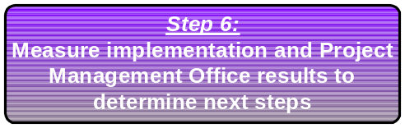
Steps to Establish a PMO
Validate what worked and didn’t work, strategize and recommend improvements
Next Steps:
Conduct lessons learned meetings
Document findings
Develop improvement strategy
Dr. Richard Scudder Copyright 2018
14
Notes:
14

Slide 15
Lessons Learned from the Field
Obtain buy-in up front - active executive support is key
Ensure that the advisory council represents key areas of your organization
Establish communication plan and clear escalation path
PMO implementation strategy requires careful planning and involvement of PM staff
  Model needs to meet the organization’s need (don’t boil the ocean)
Staffing and expertise of PMO sufficient to support rollout
  Need to be able to tie performance measurement and compensation to support/usage of PMO processes
Dr. Richard Scudder Copyright 2018
15
Notes:
15

Slide 16
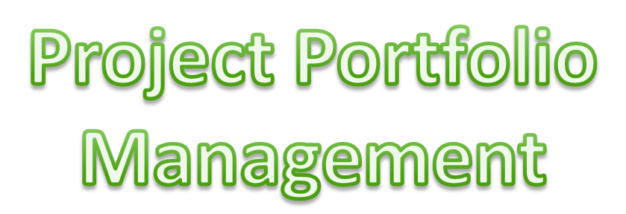
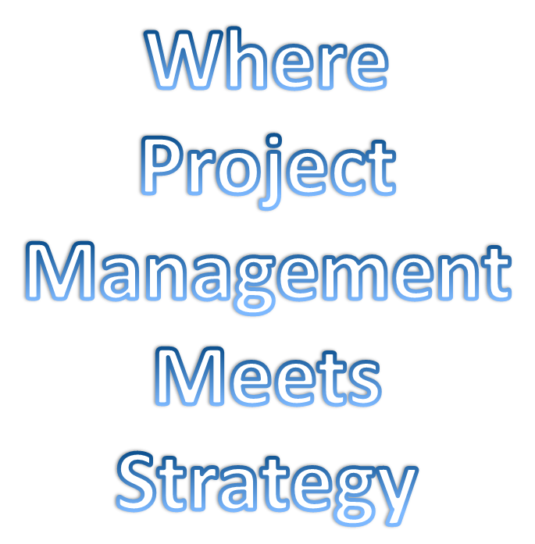

Dr. Richard Scudder Copyright 2018
16

Slide 17
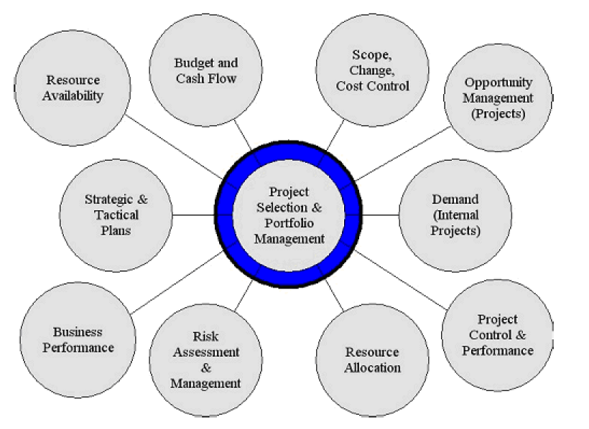
PPM as a Hub
Dr. Richard Scudder Copyright 2018
17
Notes:
17
17

Slide 18

The Project Pipeline
Ideas, Needs,Opportunities,
Bids, RFPs, Requests etc.
Business Development
An adaptation of the Wideman/Levine model
Business Planning
Portfolio Selection and Planning
Planning and Execution of Specific Projects
Screening Process
Project Management Process
Dr. Richard Scudder Copyright 2018
18
Notes:
18
18

Slide 19
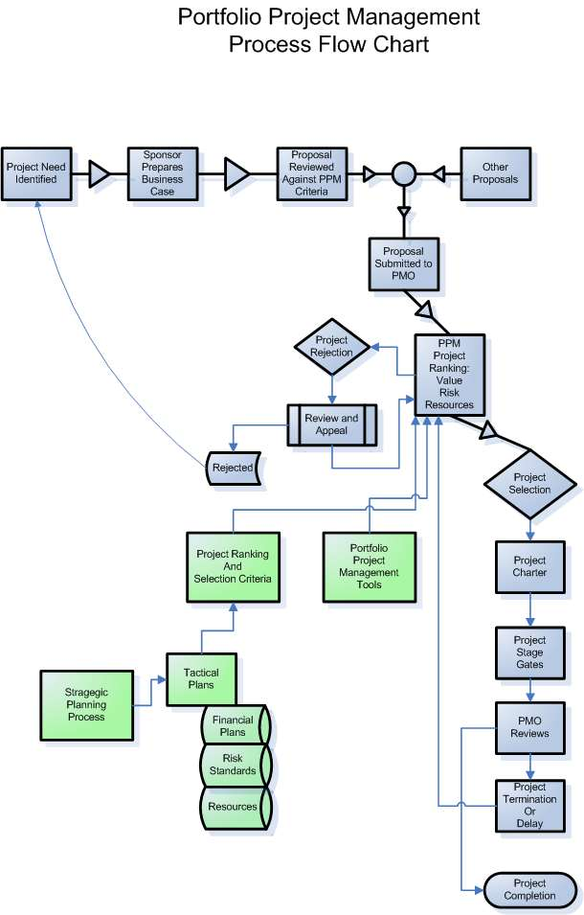
Dr. Richard Scudder Copyright 2018
19
Notes:
19
19

Slide 20
PPM Project Selection
Basic Criteria Set
Values and Benefits
  Select a mix of low and high risk project investments
  Optimize
    Project dependencies
    Complexity
    Pay off
Actively select the overall risk profile
Allocate skills (resources) across the projects
- Thornton
Dr. Richard Scudder Copyright 2018
20
Notes:
20
20
Matrix and distributed orgs have problems with understanding all but highly visible projects. To start using PPM
Consolidate…single repository of existing projects
Categorize . Consistent categories to align projects with strategy
Remove redundancies and irrelevant projects
THEN
Organize… look at categories and programs to see how work is balanced … continual monitoring Real time
Determine practices and policies. Standard methods for intiitation, justification, methodologies
Analyze and measure
Create visibility

Slide 21
PPM Selection Method
Values and Benefits
Ranking of qualitative and quantitative criteria:
  Alignment with strategic and tactical plans
  Balance between maintenance and investment
  Allocation of R&D resources
  Allocation of Marketing resources
  Probability of on-time, on-budget, within-scope
  Ancillary benefits
Financial Hurdles
  NPV, IRR, etc.
Dr. Richard Scudder Copyright 2018
21
Notes:
21
21
Question: Who owns the PPM

Slide 22
PPM Selection Method
Risk Profile
+
High Value
High Risk
High Value
Low Risk
Postpone
Shift Risk
Good To Go
Business Value
Low Value
High Risk
Low Value
Low Risk
Rethink
Retarget
Ability to execute successfully
+
Dr. Richard Scudder Copyright 2018
22
Notes:
22
22

Slide 23
PPM Selection
Method Resources
Availability
Impacts on cash flow
Current projects’ impact
Supervision, coordination and learning curve impacts
Dr. Richard Scudder Copyright 2018
23
Notes:
23
23

Slide 24
PPM Selection - NPV
Commonly used tool to determine go/no-go
Makes assumptions about future income and expense
Calculates final dollar value based on declining value of investment
Positive value required to move forward
Dr. Richard Scudder Copyright 2018
24
Notes:
24
24

Slide 25
PPM Project
Rejection Criteria
Not in line with current mission
Not in line with available resources
Not sound politically, socially, or for business relationships
Feasible technologically but not economically
Feasible economically but not technologically
Involves excessive risk
Dr. Richard Scudder Copyright 2018
25
Notes:
25
25

Slide 26
Stage Gate Framework
New Product Development filtering
Idea to Launch concept
  10% of new product launches succeed
Significant number of organizations use some form of stage gate process
Dr. Richard Scudder Copyright 2018
26
Notes:
26
26

Slide 27
Stage Gates
Each stage has required criteria, processes
Each stage adds incremental cost
Each stage decreases uncertainties and risk
Each gate requires:
  Deliverables
  Go/Kill Criteria
  Defined Outputs
Discovery
1
Idea Screen
Scoping
2
Business
Case
3
Development
4
Testing/
Validation
5
Launch
R.G Cooper
Dr. Richard Scudder Copyright 2018
27
Notes:
27
27

Slide 28

Assessing Your Portfolio
Where do we source the application?
What is the nature of the data?
What are the quality problems?
How mature are we in our processes?
Dr. Richard Scudder Copyright 2018
28
Notes:
28
28

Slide 29
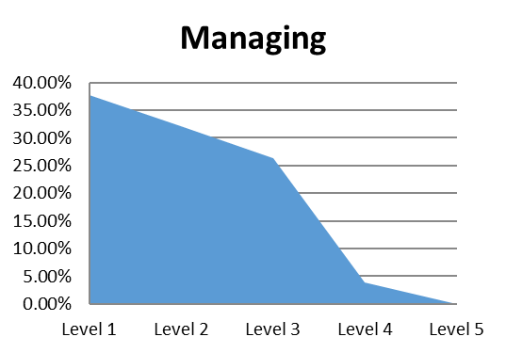

Processes for Managing Your Portfolio
Level 1
  Processes not specified
  Projects not matched with organizational strategy
Level 2
  Basic processes in place
  Review board in place for portfolio
  Alignment with strategy sometimes considered
Level 3
  Processes systematized throughout organization
  Review board reports to executive level
  Projects consistently match organizational strategy
Level 4
  Project reviews used to improve projects
  Portfolio is balanced for business value
  Organizational changes reviewed for impact on project portfolio
Level 5
  Continuous improvement
  Benchmarking
  Metrics collected and analyzed
Dr. Richard Scudder Copyright 2018
29
Based on Computer Associates Survey, 2008.

Slide 30
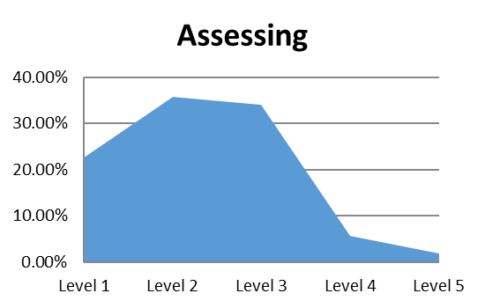
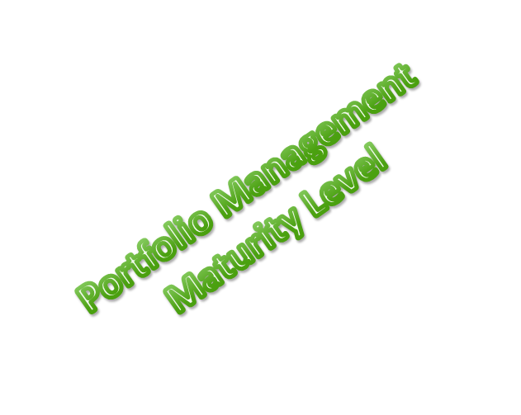
Processes for Assessing Project Opportunities
Level 1
  Processes not specified
  Unknown list of opportunities
  Project business value unknown
Level 2
  Basic processes in place
  Responsibilities for opportunity identification specified
  Projects aligned with short term needs
Level 3
  Processes systematized throughout organization
  Cost, benefits, schedule and risk reviewed for each project prior to funding
Level 4
  Project reviews used to improve projects
  Investment opportunities shared throughout organization
Level 5
  Continuous improvement
  Benchmarking
  Metrics collected and analyzed
Dr. Richard Scudder Copyright 2018
30

Slide 31
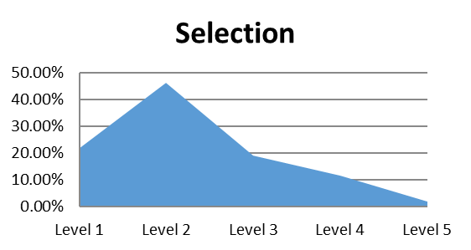
Processes for
Selecting Projects
Level 1
  Processes not specified
  Project funding information incomplete
Level 2
  Basic processes in place
  Responsibilities for business value identification specified
  Basic prioritization scheme in place
Level 3
  Processes systematized throughout organization
  Portfolio criteria for prioritization standardized at division level
Level 4
  Project prioritization validated by historical data
  Enterprise level review board selects projects using standard criteria
  Prioritization used at all levels of organization
Level 5
  Continuous improvement
  Benchmarking
  Metrics collected and analyzed
Dr. Richard Scudder Copyright 2018
31
Slide 31

Slide 32
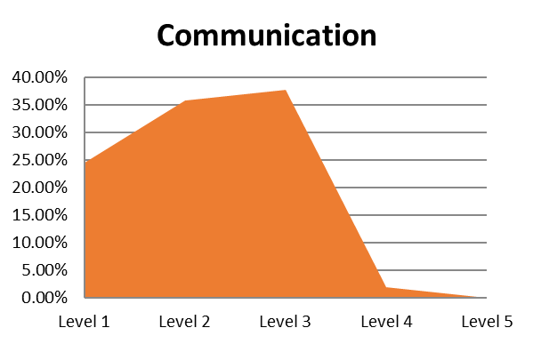
Processes for Collecting and Sharing Project Information
Level 1
  Processes not specified
  No list of approved projects
  Portfolio standards unknown
Level 2
  Basic processes in place
  Project data available at division level
  Project data communicated at division level
Level 3
  Processes systematized throughout organization
  Tracking system in place for all projects
  Portfolio information reviewed at strategic level
Level 4
  Audit system in place for portfolio
  Project information available on demand
  Asset inventory
Level 5
  Continuous improvement
  Benchmarking
  Metrics collected and analyzed
Dr. Richard Scudder Copyright 2018
32
Slide 32

Slide 33
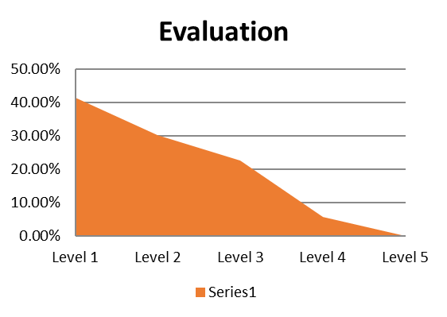
Processes for Evaluating Project Portfolio
Level 1
  Processes not specified
  Little evaluation takes place
Level 2
  Basic processes in place
  Portfolio information shared with sponsor organization
  Cost and schedule compared to estimate
Level 3
  Processes systematized throughout organization
  Portfolio actively analyzed and balanced
  Benefit and risk evaluation reviewed
Level 4
  Common objectives and metrics reviewed
  Performance data collected and analyzed
  Performance data used in prioritization
Level 5
  Continuous improvement
  Benchmarking
  Metrics collected and analyzed
Dr. Richard Scudder Copyright 2018
33
Slide 33

Slide 34

Processes for Portfolio Resource Management
Level 1
  Processes not specified
  Resources assigned as available
Level 2
  Basic processes in place
  Resources identified for skill and experience
  Collaborative resource management process in place
Level 3
  Processes systematized throughout organization
  Organization wide resource pool
  All resources considered
Level 4
  Project reviews used to improve projects
  Enterprise wide resource reporting
Level 5
  Continuous improvement
  Benchmarking
  Metrics collected and analyzed
Dr. Richard Scudder Copyright 2018
34
Slide 34

Slide 35
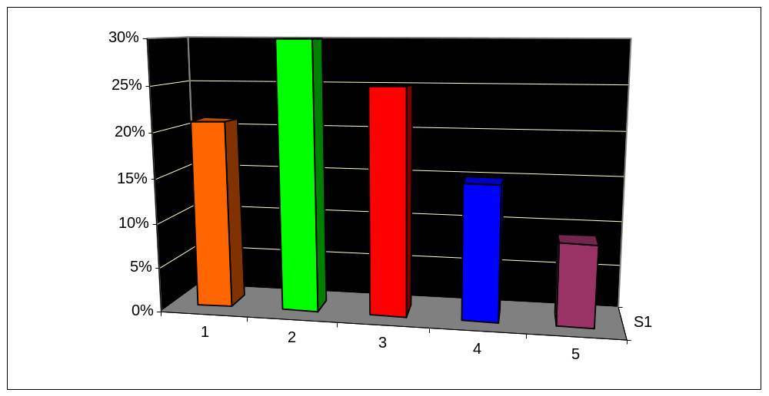
Organizational Portfolio Management
Level 1: No Portfolio Management
Level 2: Database of Projects Exists: Value Assessed for Individual Projects
Level 3: Project Selection/Prioritization Occurs at Business Unit Level
Level 4: Project Portfolio Actively Managed at Business Unit Level
Level 5: Project Portfolio Actively Managed at Enterprise Level
Dr. Richard Scudder Copyright 2018
35
Center for Business Practices, 2005

Slide 36
Benefits
Those organizations ranking higher in PPM Practices report:
  Better alignment with business strategy (70.4%)
  Working on the right projects (57%)
  Spending in the right areas (46.3%)
  Increased cost savings (42.6%)
Dr. Richard Scudder Copyright 2018
36
Center for Business Practices, 2005

Slide 37
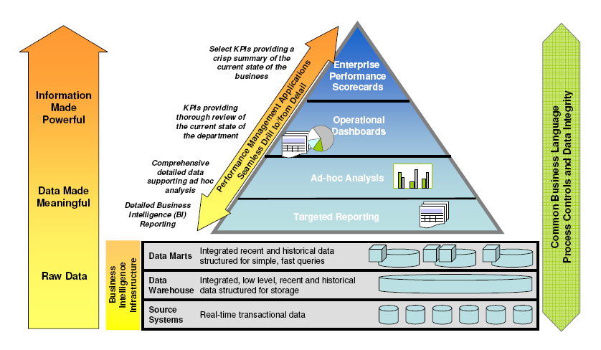
Dr. Richard Scudder Copyright 2018
37

Slide 38
Benefits of Scorecards and Dashboards to the Project Management Executive
In a single glance, the executive can see a wide swath of the organization: finance, manufacturing, sales, marketing, and more
Immediate value is gained without the need for the executive to perform analysis
Executives see not just actual values, but comparisons to plans or prior results
Dr. Richard Scudder Copyright 2018
38
Notes:
38
Business executives are busy people, and scorecards provide them with a single view that shows the overall health of the entire business. Executives don’t have time to wade through a 100 page report to decide if defect rates are improving or worsening. Instead, scorecards give the executive immediate feedback without him or her having to first perform complex analysis. Executives can now identify trouble spots much more quickly and work to act on those areas.

